Slide 1
Macro Announcement Days
Quant Team
Ellie Evans, Brandon Ly, Mark Rose

Slide 2
Why macro announcement days matter
CAPM says market beta should be sole determinant of excess returns
Historically, low beta stocks outperform high beta stocks
Frazzini & Pedersen (2014); Bates & Boyer (2020)
Does a high beta ever correspond with high excess returns?
If we can predict when this relationship will hold, we can time our BAB (betting against beta) strategy
Notes:
Stock market average returns and Sharpe ratios are signiÖcantly higher on days when important macroeconomic news about ináation, unemployment, or interest rates is scheduled for announcement.

Slide 3
Replicating beta-stock return relationships
Savor & Mungo (2013) split trading days into:
announcement days (a-days)
non-announcement days (n-days)
A-days: scheduled FOMC interest rate meetings, CPI/PPI announcements, and unemployment announcements
We use time series Fama-MacBeth regressions on stock portfolios & individual stocks

Slide 4
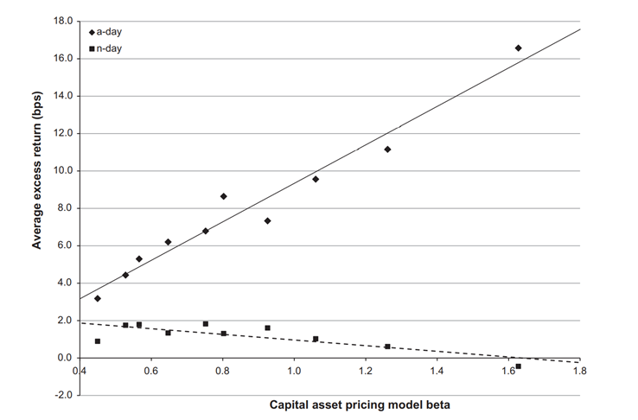

Slide 5
Fama-Macbeth Regression Method
Get rolling? 1-year betas (every day) for all stocks
Sort stocks into 10 beta-decile portfolios (rebalanced monthly)
Calculate value-weighted return on 10 portfolios
Get 1-year betas (every day) for all 10 portfolios across time
Separate data into a-days & n-days
Do regressions of excess returns of test assets on beta of test assets
Notes:
Regress excess returns of 10 beta portfolios on (excess) market returns to get alpha relative to the market I didn’t do this
Yeah I was just trying to put it into words? Idk mostly when working it out with Mark nbd
Gotcha. So that’s the confusing thing is bc this study wasn’t necessarily for a factor model trading strategy. We’re trying to morph it into that. So in a nutshell the first 5 slides are theory, and then slides 6+ are going to be more related to our investing thesis.
Makes sense.✓

Slide 6
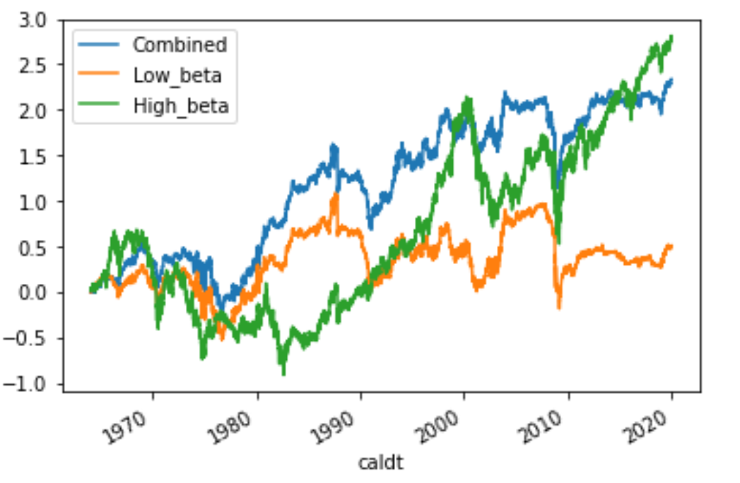
Cumulative Excess Returns
“Beta” of High Portfolio: 1.55
“Beta” of Low Portfolio: 0.15
“Beta” of Combined Portfolio: 0.29

Slide 7
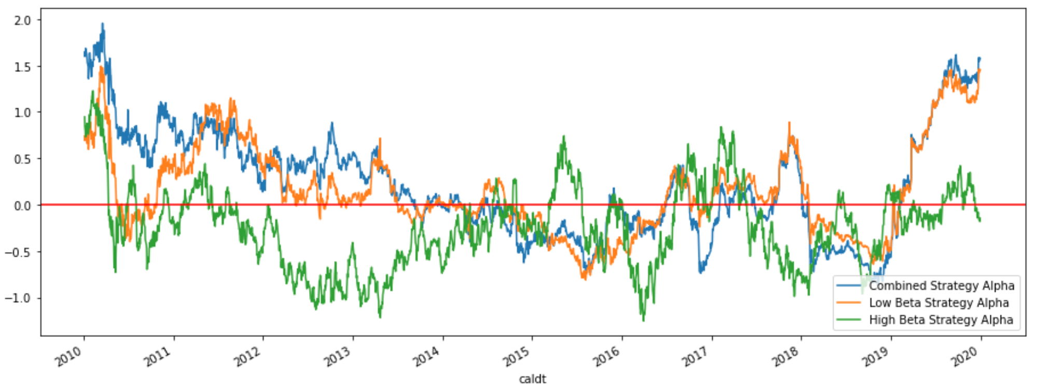
Alpha (annualized percent) 2010-2019 - 1 Year Moving Average
High Portfolio Avg Alpha: -0.247 Low Portfolio Avg Alpha: 0.156 Combined Portfolio Avg Alpha: 0.224
Averages

Slide 8
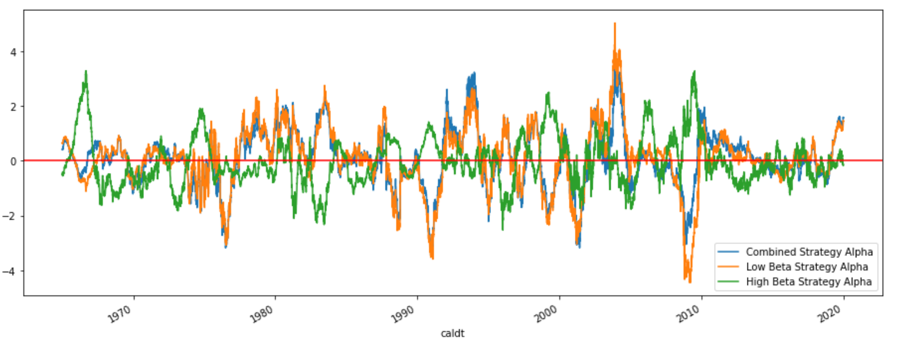
Alpha (annualized percent), 1 yr Moving Avg

Slide 9
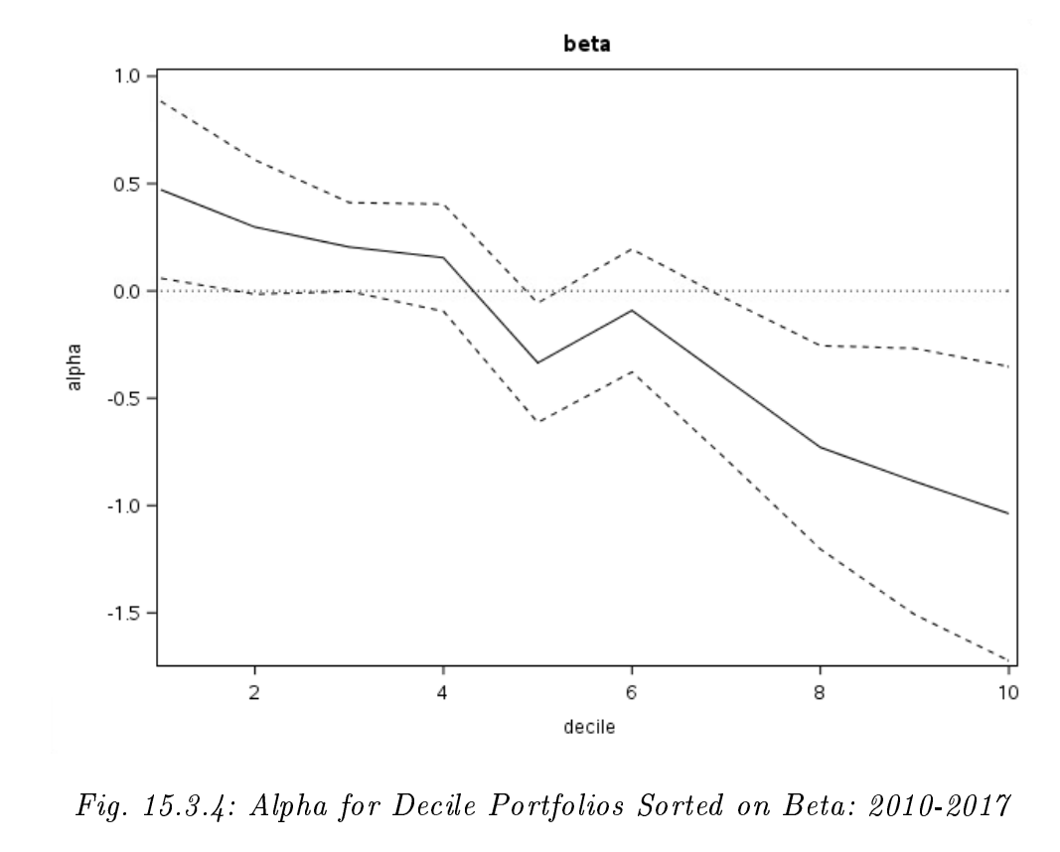
Results confirm Bates/Boyer

Slide 11
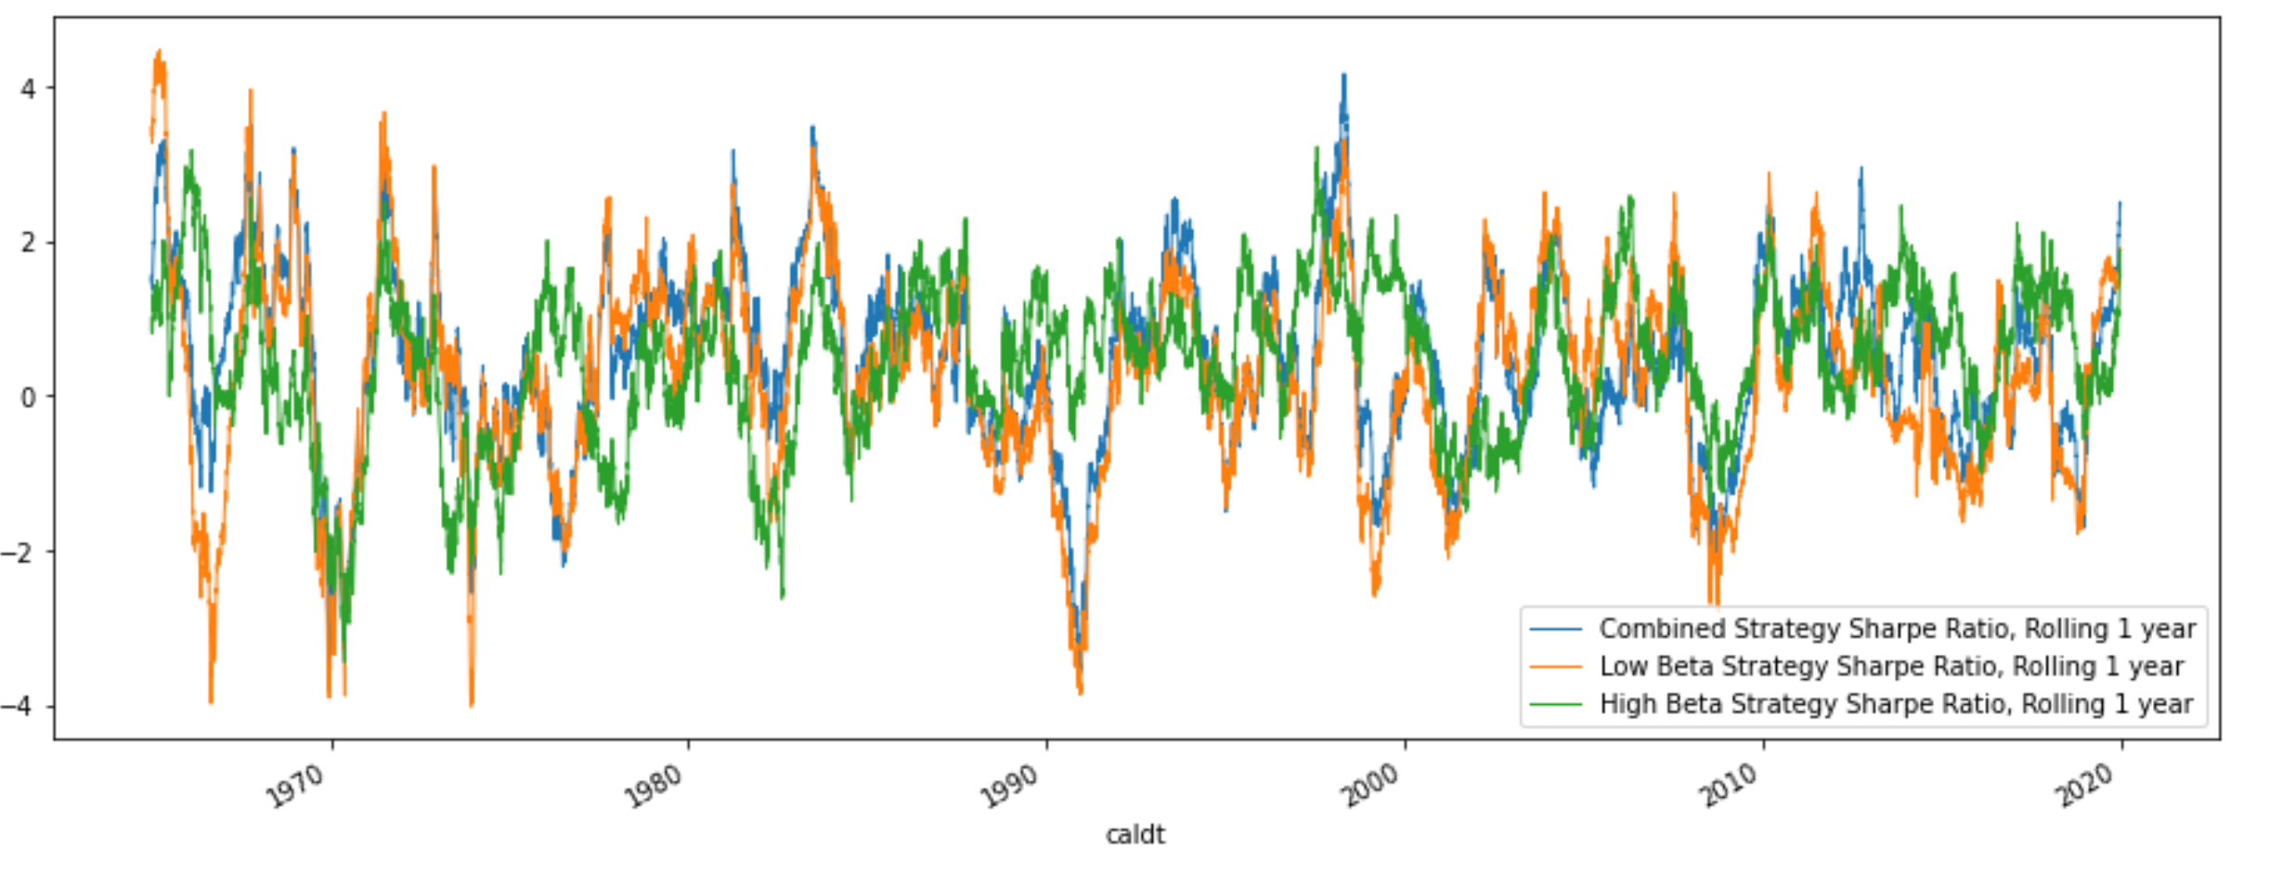
Sharpe Ratio (annualized), 1 yr Moving Avg

